Slide 1
Topic 2
Writing First C/C++ Program

Slide 2
Smallest C Program
A C/C++ program consists of one or more blocks of code called functions.
Minimum number of functions in a program is one.
The name of one of the functions must be main.
The main function is where program execution begins.

Slide 3
Smallest C Program
When a C/C++ program runs, it gives back a result to indicate whether program execution is successful.
0 (zero) shows successful execution.
Non-zero shows there was some problem.

Slide 4
Data Type int and Constant
The numbers (0,1,2, etc.) are integers i.e. whole numbers which do not have decimal point.
Integer values are one category of constants i.e. values that appear in a program.
In C/C++, this type of numbers belong to a group called int i.e. this type of data or this data type is called int type.

Slide 5
The main Function
Smallest C/C++ program has these lines:
Function header – marks the beginning of a function.
Indicates that the function name is main and the function gives back an integer type value (int) and the function does not need any information (void).
int main(void)
{
return 0;
}

Slide 6
The main Function
Smallest C/C++ program has these lines:
int main(void)
{
return 0;
}
Opening curly brace - indicates the start of the body of the function.
Closing curly brace - indicates the end of the body of the function.

Slide 7
The main Function
Smallest C/C++ program has these lines:
int main(void)
{
return 0;
}
The return statement terminates the execution of the function and returns control to the operating system. It also gives back the function’s result.
Zero indicates the program executed without error.

Slide 8
Statements
A statement causes an action to be performed by the program.
It translates directly into one or more machine language instructions.

Slide 9
Statements
int main(void)
{
return 0;
}
Notice the statement ends with a semicolon (;).

Slide 10
Statements
This program can run but it doesn’t do anything.
int main(void)
{
return 0;
}

Slide 11
Input-Process-Output
The simplest program that does some useful work should:
get some input data,
process that data, and
produce some output result.
Process
Input
Output

Slide 12
Working with Data
A program usually processes data.
But how do we store the data?
In memory cells
How does the program refer to these memory cells?
By giving names to the memory cells.
Example names are x, y, number, n1, n2.

Slide 13
Declaration Statement
Before we can use a memory cell in the program, we need to tell the compiler the name and the type of data it will store.
We do this using a declaration.
Example:
Declaration that tells the compiler the name of the memory cell is x and the type of data it will store is integer.
int x;

Slide 14
Declaration Statement
We can declare more than one name in one declaration.
Example:
Tells compiler the program uses 3 memory cells with the names x, y and z to store integer values.
Notice the names are separated by commas (,).
int x, y, z;

Slide 15
Assignment Statement
How do we tell the program to store a value in the memory cell?
By writing an assignment statement.
Example:
Assignment statement that tells the program to store/assign the value 5 in the memory cell with the name x.
= is the assignment operator. It does not mean equal.
x = 5;

Slide 16
Assignment Statement
How do we tell the program to store a value in the memory cell?
By writing an assignment statement.
Example:
Think of it like this:
x 5
which you can read as:
“put the value 5 in the memory
cell with the name x”
or simply:
“assign 5 to x”
or “x becomes 5”.
x = 5;

Slide 17
Assignment Statement
How do we tell the program to store a value in the memory cell?
By writing an assignment statement.
Example:
We can describe this in picture form as:
x = 5;
5
x

Slide 18
Assignment Statement
How do we tell the program to copy a value from one memory cell to another?
Use assignment statement.
Example:
x
5
x = 5;
y = x;

Slide 19
Assignment Statement
How do we tell the program to copy a value from one memory cell to another?
Use assignment statement
Example:
x
5
x = 5;
y = x;
Copy value of x into y
y

Slide 20
Assignment Statement
How do we tell the program to copy a value from one memory cell to another?
Use assignment statement
Example:
x
5
x = 5;
y = x;
Copy value of x into y
y
5

Slide 21
Complete Program
int main(void)
{
int x, y;
x = 5;
y = x;
return 0;
}

Slide 22
Complete Program
int main(void)
{
int x, y;
x = 5;
y = x;
return 0;
}
Function Header
Function Body

Slide 23
Complete Program
int main(void)
{
int x, y;
x = 5;
y = x;
return 0;
}
Declarations
Statements

Slide 24
Complete Program
int main(void)
{
int x, y;
x = 5;
y = x;
return 0;
}
Assignment statements
return statement

Slide 25
Showing Results
The above program will run but it does not show any results.
Everything happens inside the computer’s main memory only.
How do we make the program display the values stored in the memory cells?
By using the standard output stream. A stream is an entity where a program can either insert or extract characters to/from. There is no need to know details about the media associated to the stream or any of its internal specifications.
For formatted output operations, cout is used together with the insertion operator, which is written as << (i.e., two "less than" signs).

Slide 26
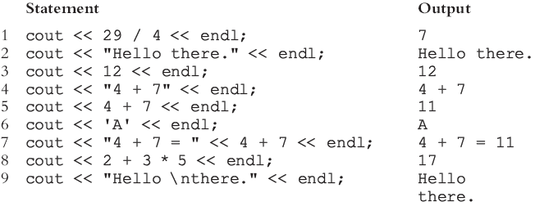
Showing Results
How do we tell object cout what to display?
The syntax of cout and << is:
Example:

Slide 27
Showing Results
Note that
A manipulator is used to format the output
Example: endl causes insertion point to move to the beginning of the next line.
The new line character is '\n'
May appear anywhere in the string. E.g.:
cout << "Hello there. ";
cout << "My name is James.";
Output:
Hello there. My name is James.
cout << "Hello there.\n";
cout << "My name is James.";
Output :
Hello there.
My name is James.

Slide 28
Showing Results

Slide 29
Program Now
int main(void)
{
int x, y;
x = 5;
y = x;
cout << "y = " << y;
return 0;
}

Slide 30
Showing Results
The cout object is same as some other functions available in standard libraries.
A library is a collection of classes and functions that support for some language features, and everyday functions for tasks such as finding the square root of a number.
The information for the cout object is in a file called iostream.

Slide 31
Showing Results
For the program to use cout object, this information must be inserted into the program.
To do this , we add this line in our program:
#include <iostream>
This is called a preprocessor directive.
A preprocessor or precompiler processes the text of a program before it is compiled.

Slide 32
Showing Results
Each library in C has a standard header file whose name ends with .h which contains information about the functions; However, no other headers in the C++ Standard Library end in ".h”
cin and cout are declared in the header file iostream, but within std namespace
To use cin and cout in a program, use the following two statements:
#include <iostream>
using namespace std;

Slide 33
Complete Program
#include <iostream>
using namespace std;
int main(void)
{
int x, y;
x = 5;
y = x;
cout << "y = " << y;
return 0;
}
Memory Cells
x
5
y
5
Computer Screen
y = 5

Slide 34
Showing Results
How do we make the program display the following?
y is 5
5 is the value in y.
cout << "y is " << y;
cout << y << " is the value in y.";

Slide 35
Computation – Arithmetic Operators
How do we make the program do some computation or calculation?
Use arithmetic operators.
Operator | In Maths | In C
Add | a + b | a + b
Subtract | a - b | a - b
Multiply | ab | a * b
Divide | or a / b or a ÷ b | a / b
Modulus | a mod b | a % b
a
---
b

Slide 36
Variables
Programs store data in memory cells.
A memory cell has a name, a data type, a value, and an address.
In programming, these memory cells are called variables because the value in the memory cell can change.

Slide 37
Variable Declaration and Assignment
Variable declaration – tells compiler the name and data type of the variable (i.e. memory cell).
int n;
n = 72;
Assigns value 72 to variable n (i.e. memory cell with name n).

Slide 38
Variable Declaration and Assignment
int n;
n = 72;
Only variables are allowed on the left-hand side of an assignment statement.

Slide 39
Getting Input Data
How do we make a program input the data from the program user in order to do computation?
By using the standard input stream.
For formatted output operations, cin is used together with the extraction operator, which is written as >> (i.e., two "greater than" signs).
After we get the data, where do we store it?
In a variable

Slide 40

Getting Input Data
How do we tell object cin where to store the data?
The syntax of cin and >> is:
Example:
If miles is a double variable
cin >> miles;
Causes computer to get a value of type double
Places it in the variable miles

Slide 41
Getting Input Data
Using more than one variable in cin allows more than one value to be read at a time
For example, if feet and inches are variables of type int, a statement such as:
cin >> feet >> inches;
Inputs two integers from the keyboard
Places them in variables feet and inches respectively

Slide 42
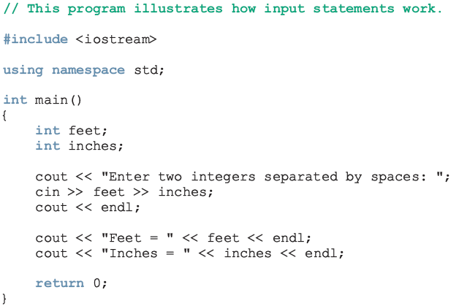
Getting Input Data

Slide 43
Getting Input Data
Just like for the object cout, the iostream file provides additional information about the object cout.
We need to add the preprocessor directive in our program:
#include <iostream>
using namespace std;

Slide 44
Complete Program
#include <iostream>
using namespace std;
int main(void)
{
int num;
cin >> num;
return 0;
}

Slide 45
Getting Input Data
Better to let the user know that the program is expecting some data.
How do we do this?
We display a prompt using cout object
Computer Screen
Cursor appears and program waits for the user to enter a number.
_

Slide 46
Complete Program
#include <iostream>
using namespace std;
int main(void)
{
int num;
cout << "Enter a number: ";
cin >> num;
return 0;
}
Displays a prompt.
Getting input data

Slide 47
Getting Input Data
Computer Screen
Cursor appears and program waits for the user to enter a number
Enter a number: _
Prompt displayed by cout object

Slide 48
Getting Input Data
Computer Screen
User types a number and presses “Enter” key.
The input data is stored as an integer in the variable num.
Enter a number: 91
num
91

Slide 49
Getting Input Data
Computer Screen
User types a number and presses “Enter” key.
The input data is stored as an integer in the variable num.
Enter a number: 91
Note: the underline is used to show that this is data entered by the user.
num
91

Slide 50
Store a value into variable
There are two ways to store a value into variable:
int num;
By using the assignment statement
num = 35;
By using a read statement
cin >> num;

Slide 51
What does this program do?
#include <iostream>
using namespace std;
int main(void)
{
int num, num_power2;
cout << "Enter n: ";
cin >> num;
num_power2 = num * num;
cout << "n x n = " << num_power2 << endl;
return 0;
}

Slide 52
What does this program do?
Computer Screen
5
num
Enter n: 5
n x n = 25
25
num_power2

Slide 53
What does this program do?
#include <iostream>
using namespace std;
int main(void)
{
int a, b, sum;
cout << "Enter a: ";
cin >> a;
cout << "Enter b: ";
cin >> b;
sum = a + b;
cout << "a + b = " << sum << endl;
return 0;
}

Slide 54
What does this program do?
Computer Screen
531
a
Enter a: 531
Enter b: 24
a + b = 555
24
b
555
sum

Slide 55
What does this program do?
#include <iostream>
using namespace std;
int main(void)
{
int a, b, sum;
cout << "Enter a and b: ";
cin >> a >> b;
sum = a + b;
cout << a << " + " << b << " = " << sum << endl;
return 0;
}

Slide 56
What does this program do?
Enter a and b: 531 24
a
531
b
24
sum
?

Slide 57
What does this program do?
Enter a and b: 531 24
531 + 24 = 555
a
531
b
24
sum
555

Slide 58
What does this program do?
#include <iostream>
using namespace std;
int main(void)
{
int a, b;
a = 3;
b = 5;
cout << "a = " << a << ", b = " << b << endl;
a = b;
b = a;
cout << "a = " << a << ", b = " << b << endl;
return 0;
}

Slide 59
What does this program do?
a = 3;
b = 5;
a
3
b
?
a = b;
b = a;

Slide 60
What does this program do?
a = 3;
b = 5;
a
3
b
5
a = b;
b = a;

Slide 61
What does this program do?
a = 3;
b = 5;
a
5
b
5
a = b;
b = a;

Slide 62
What does this program do?
a = 3;
b = 5;
a
5
b
5
a = b;
b = a;

Slide 63
What does this program do?
#include <iostream>
using namespace std;
int main(void)
{
int a, b, temp;
a = 3;
b = 5;
cout << "a = " << a
<< ", b = " << b << endl;

Slide 64
What does this program do?
temp = a;
a = b;
b = temp;
cout << "a = " << a
<< ", b = " << b << endl;
return 0;
}

Slide 65
What does this program do?
a = 3;
b = 5;
a
3
b
?
?
temp
temp = a;
a = b;
b = temp;

Slide 66
What does this program do?
a = 3;
b = 5;
a
3
b
5
?
temp
temp = a;
a = b;
b = temp;

Slide 67
What does this program do?
a = 3;
b = 5;
a
3
b
5
3
temp
temp = a;
a = b;
b = temp;

Slide 68
What does this program do?
a = 3;
b = 5;
a
5
b
5
3
temp
temp = a;
a = b;
b = temp;

Slide 69
What does this program do?
a = 3;
b = 5;
a
5
b
3
3
temp
temp = a;
a = b;
b = temp;

